Slide 1
Physics 111: Mechanics Lecture 3
Dahiru Sanni

Slide 2
Motion in Two Dimensions
Reminder of vectors and vector algebra
Displacement and position in 2-D
Average and instantaneous velocity in 2-D
Average and instantaneous acceleration in 2-D
Projectile motion
Uniform circular motion
Relative velocity*
February 5-8, 2013

Slide 3
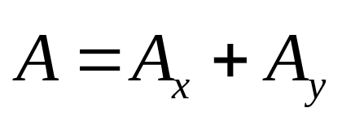
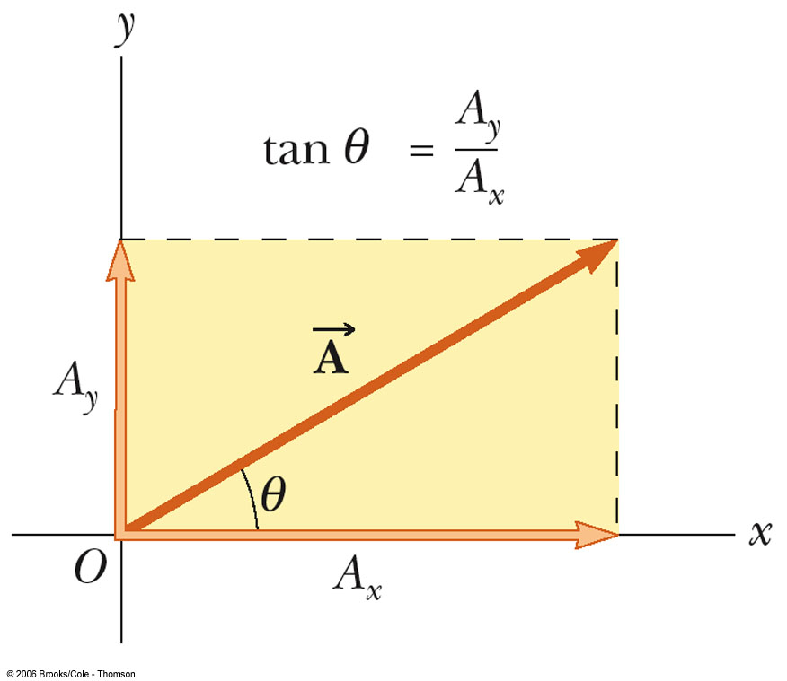
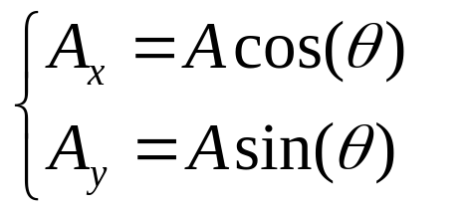
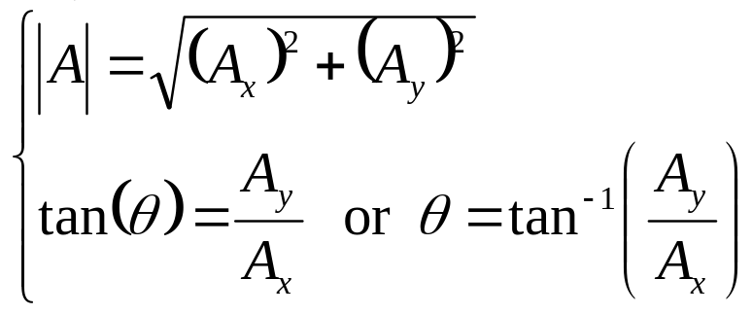
Vector and its components
The components are the legs of the right triangle whose hypotenuse is A
Or,
February 5-8, 2013

Slide 4
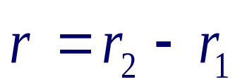




Vector Algebra
Which diagram can represent ?
A) B)
C) D)
February 5-8, 2013

Slide 5



Motion in two dimensions
Kinematic variables in one dimension
  Position: x(t) m
  Velocity: v(t) m/s
  Acceleration: a(t) m/s²
Kinematic variables in three dimensions
  Position: m
  Velocity: m/s
  Acceleration: m/s²
All are vectors: have direction and magnitudes
x
y
j
i
x
k
z
February 5-8, 2013

Slide 6
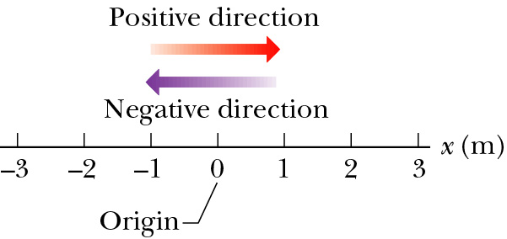


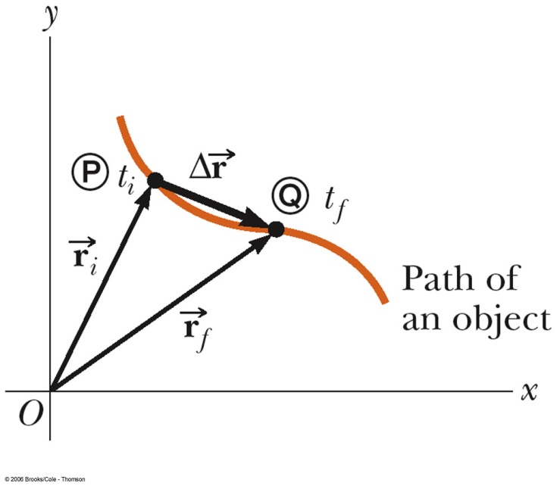

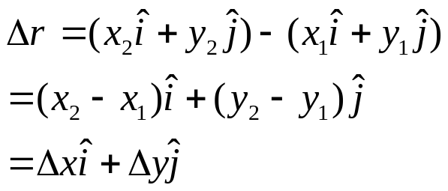
Position and Displacement
In one dimension
In two dimensions
  Position: the position of an object is described by its position vector --always points to particle from origin.
  Displacement:
x₁ (t₁) = - 3.0 m, x₂ (t₂) = + 1.0 m
Δx = +1.0 m + 3.0 m = +4.0 m
February 5-8, 2013

Slide 7
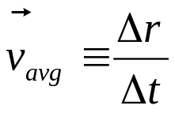
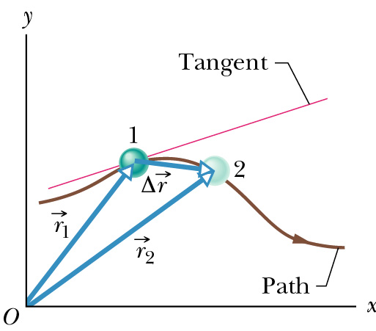
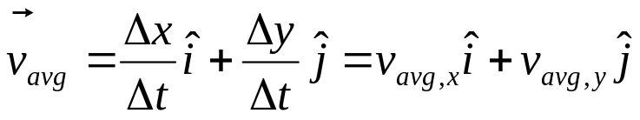
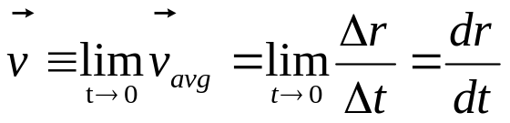
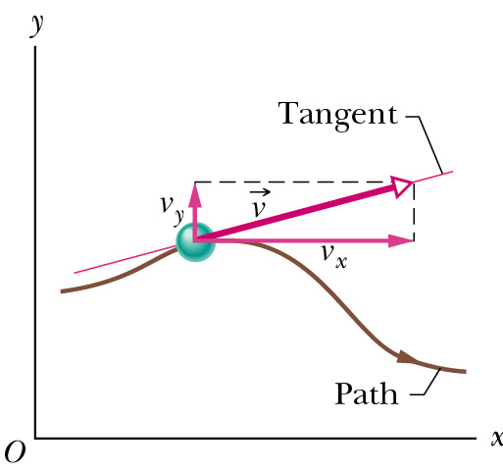
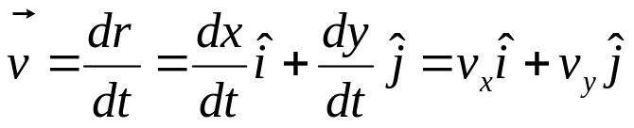
Average & Instantaneous Velocity
Average velocity
Instantaneous velocity
v is tangent to the path in x-y graph;
February 5-8, 2013

Slide 8
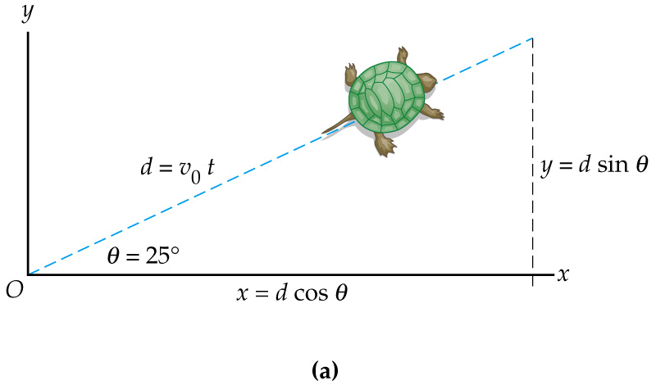
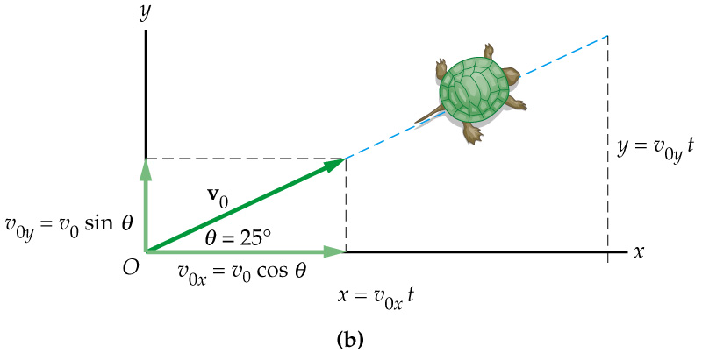
Example 1
A turtle starts at the origin and moves with the speed of v₀=10 cm/s in the direction of 25° to the horizontal.
(a) Find the coordinates of a turtle 10 seconds later.
(b) How far did the turtle walk in 10 seconds?
February 5-8, 2013

Slide 9
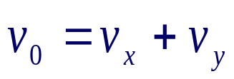



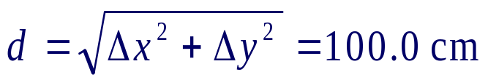
Motion of a Turtle
Notice, you can solve the equations independently for the horizontal (x) and vertical (y) components of motion and then combine them!
X components:
Y components:
Distance from the origin:
February 5-8, 2013

Slide 10
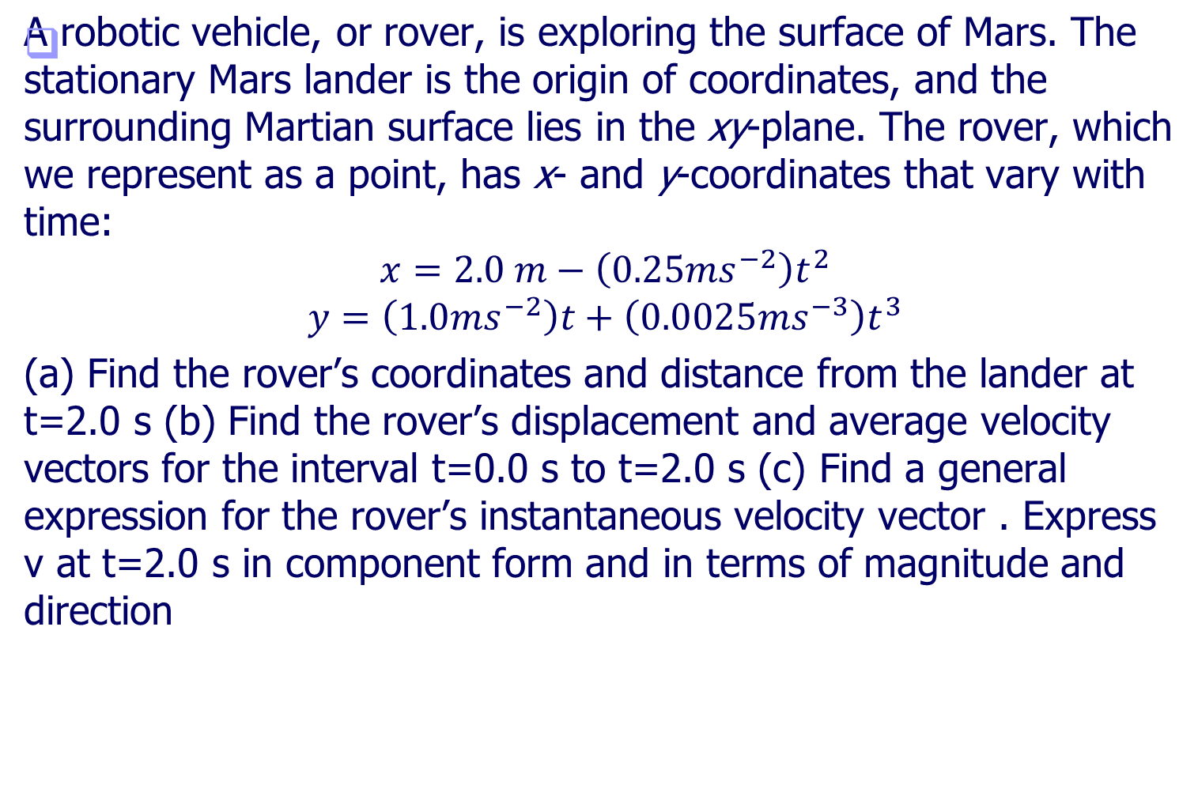
Example 2
February 5-8, 2013

Slide 11
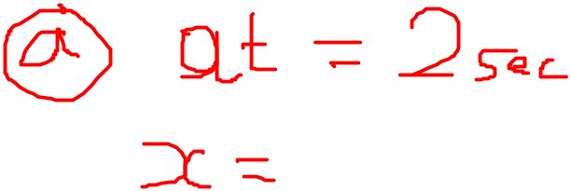
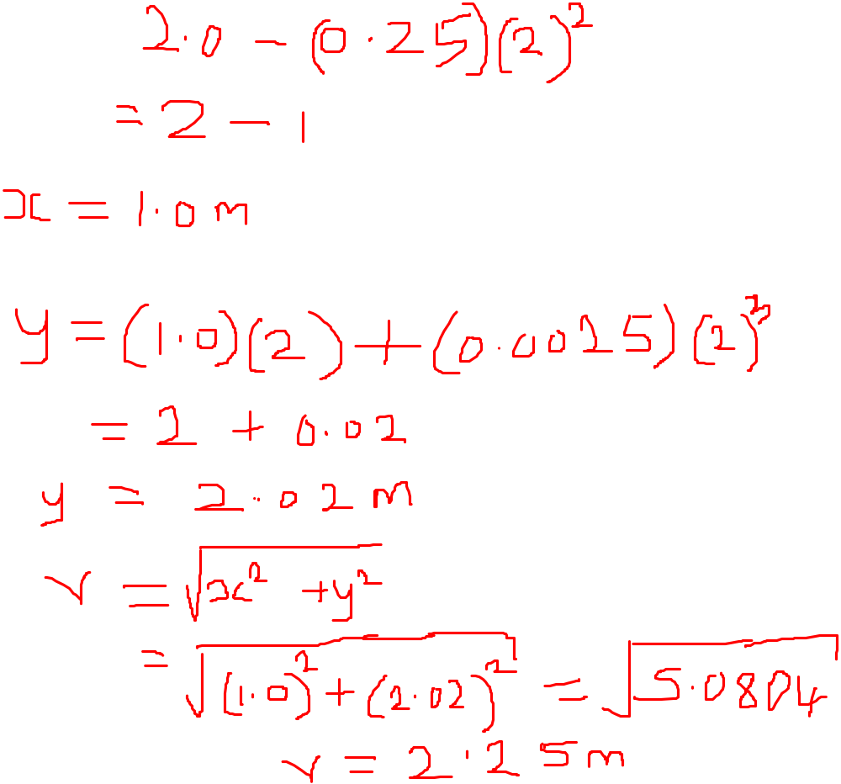

Slide 12
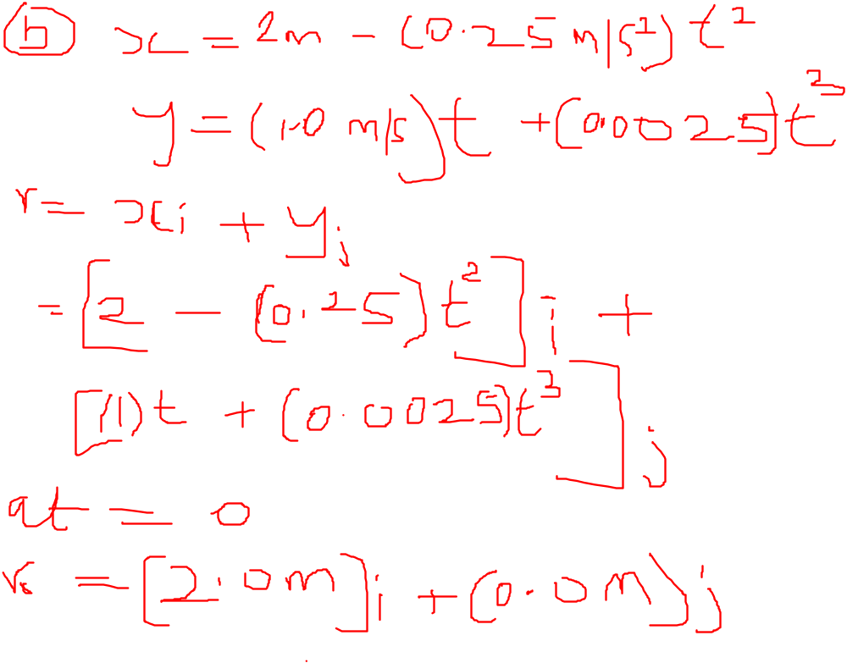
February 5-8, 2013

Slide 13
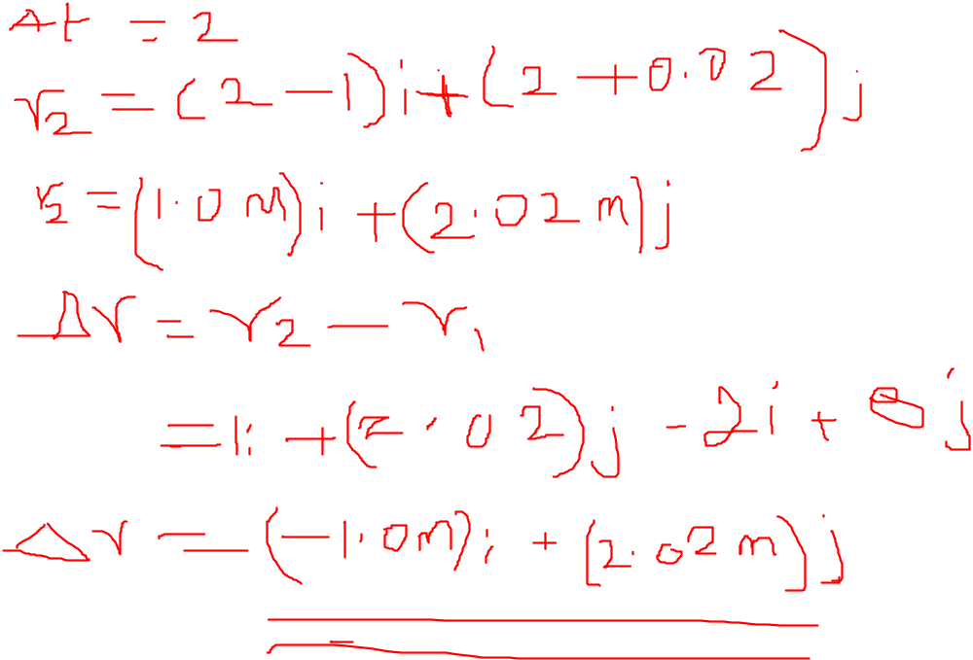
February 5-8, 2013

Slide 14
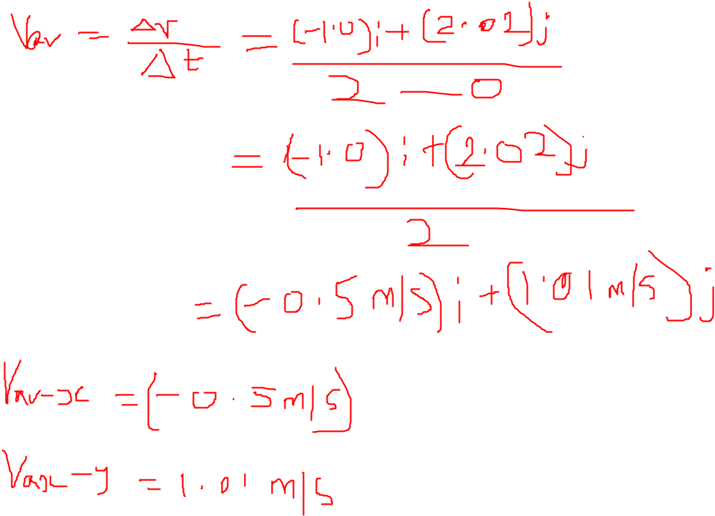
February 5-8, 2013

Slide 15
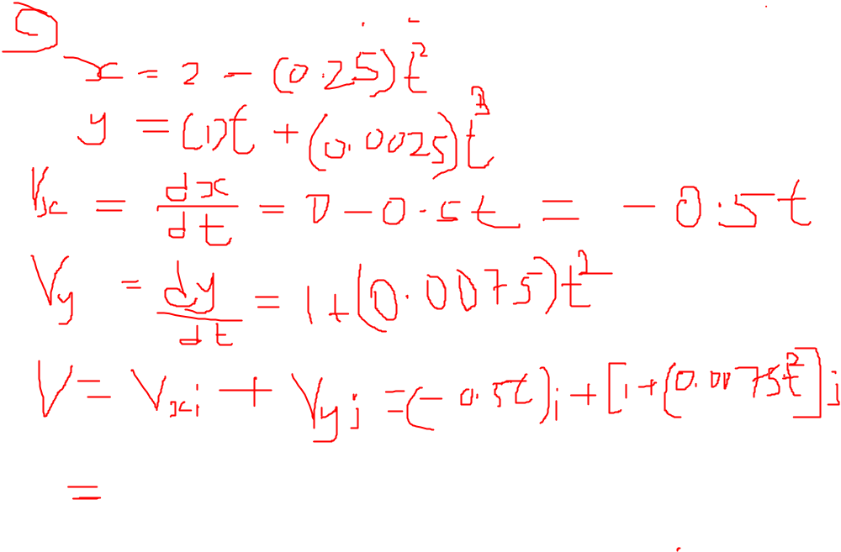
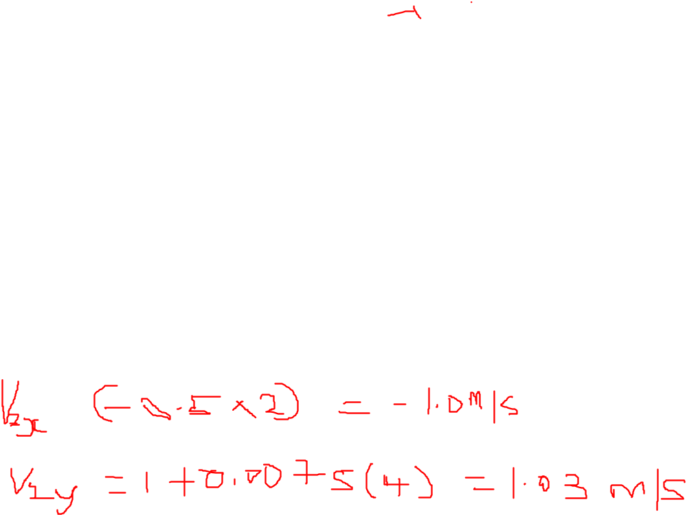
February 5-8, 2013

Slide 16
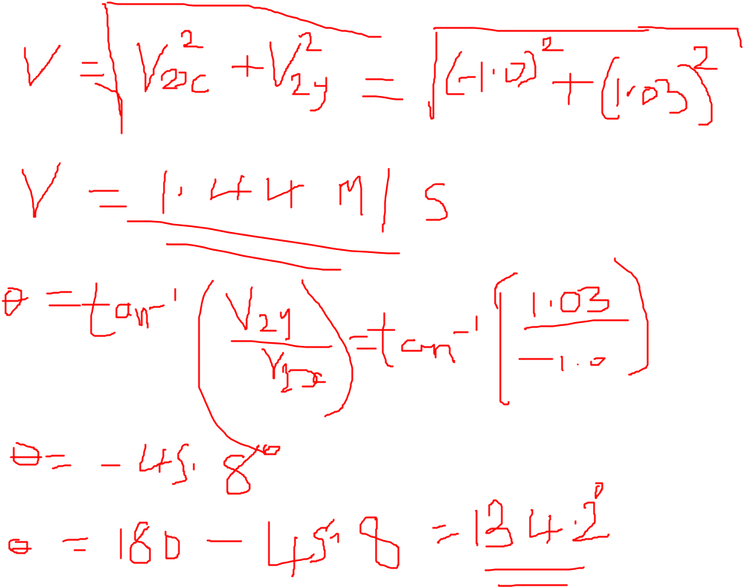
February 5-8, 2013

Slide 17
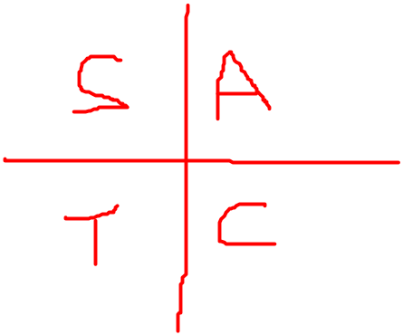
February 5-8, 2013

Slide 18
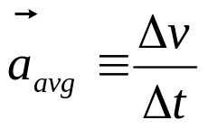
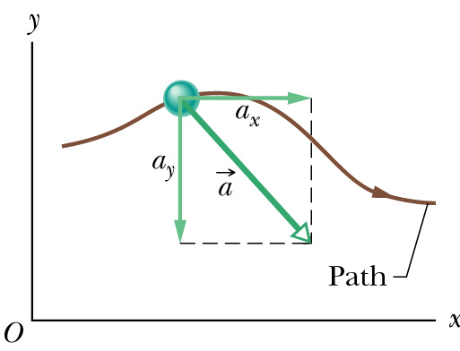
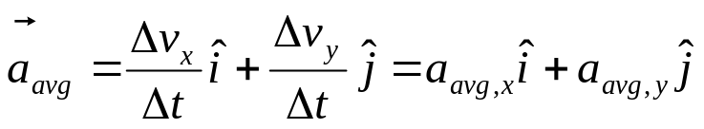
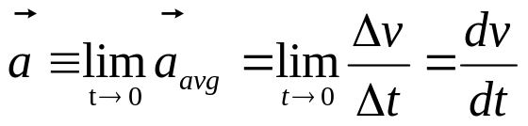
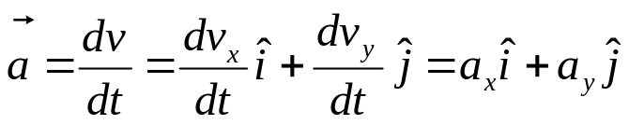
Average & Instantaneous Acceleration
Average acceleration
Instantaneous acceleration
The magnitude of the velocity (the speed) can change
The direction of the velocity can change, even though the magnitude is constant
Both the magnitude and the direction can change
February 5-8, 2013
Notes:
The average acceleration is defined as the rate at which the velocity changes. The instantaneous acceleration is the limit of the average acceleration as Δt approaches zero

Slide 19

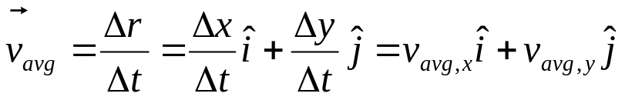
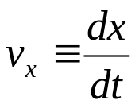
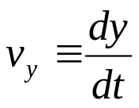
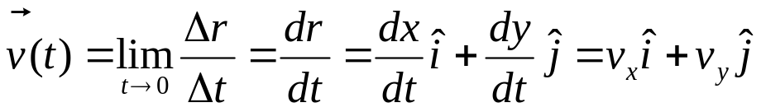
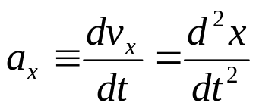
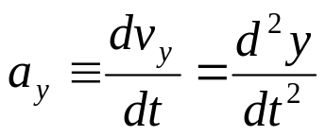
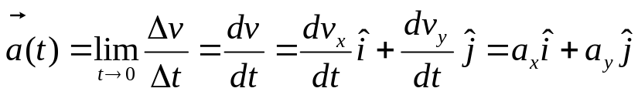

Summary in two dimension
Position
Average velocity
Instantaneous velocity
Acceleration
are not necessarily same direction.
February 5-8, 2013

Slide 20
Using the information in example 2 (a) Find the components of the average acceleration for the interval t=0.0 s to t=2.0 s (b) Find the instantaneous acceleration at t=2.0 s
February 5-8, 2013

Slide 21
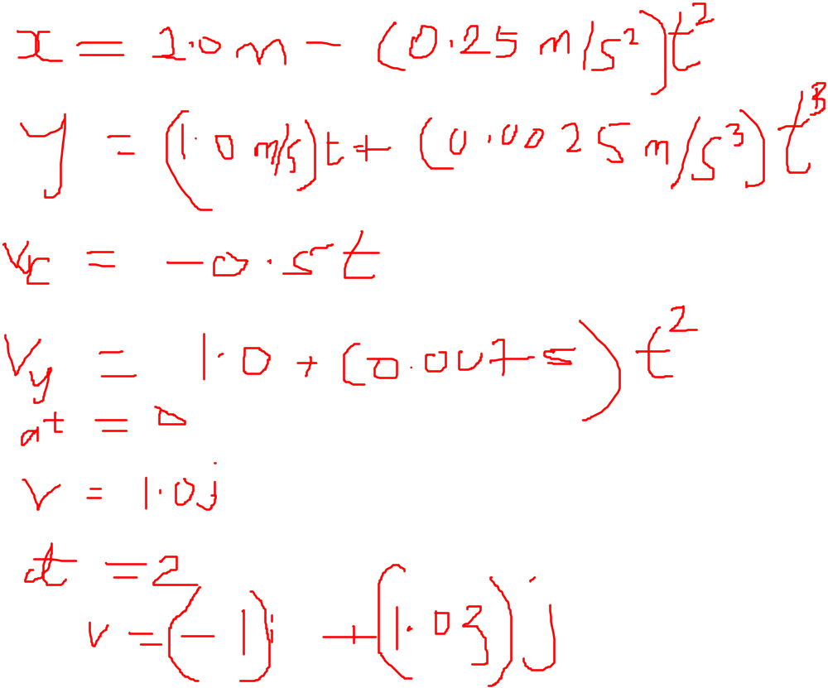
February 5-8, 2013

Slide 22
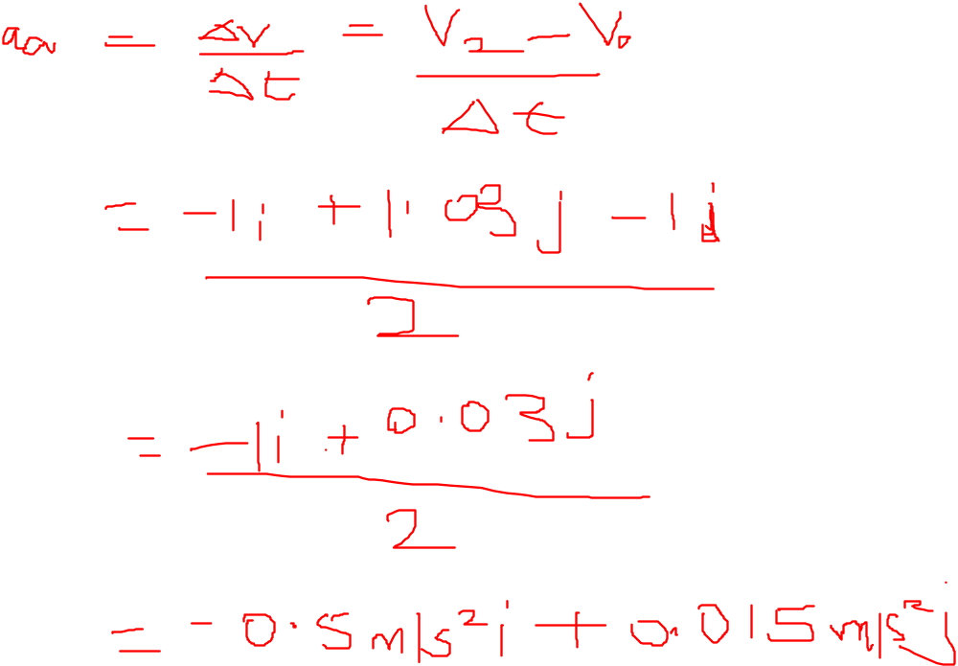
February 5-8, 2013

Slide 23
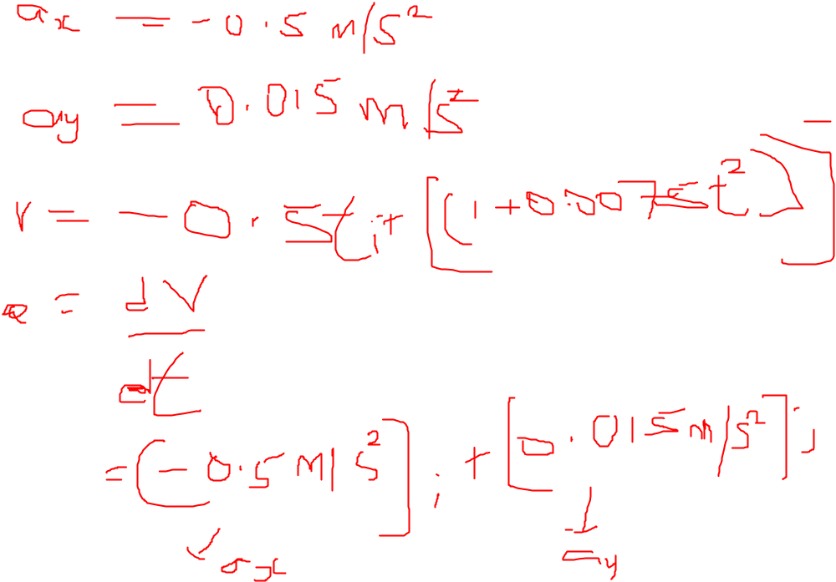
February 5-8, 2013

Slide 24
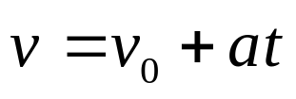
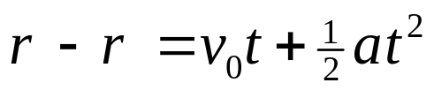
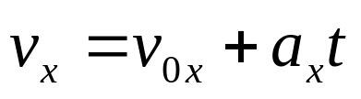
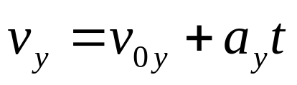
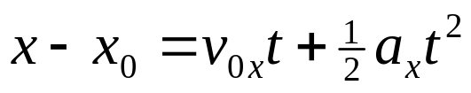
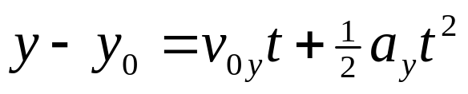
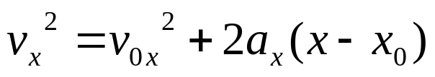




Motion in two dimensions
Motions in each dimension are independent components
Constant acceleration equations
Constant acceleration equations hold in each dimension
  t = 0 beginning of the process;
  where a_{x} and a_{y} are constant;
  Initial velocity initial displacement ;
February 5-8, 2013

Slide 25
Hints for solving problems
Define coordinate system. Make sketch showing axes, origin.
List known quantities. Find v_{0x} , v_{0y} , a_{x} , a_{y} , etc. Show initial conditions on sketch.
List equations of motion to see which ones to use.
Time t is the same for x and y directions.
x₀ = x(t = 0), y₀ = y(t = 0), v_{0x} = v_{x}(t = 0), v_{0y} = v_{y}(t = 0).
Have an axis point along the direction of a if it is constant.
February 5-8, 2013

Slide 26


Projectile Motion
2-D problem and define a coordinate system: x- horizontal, y- vertical (up +)
Try to pick x₀ = 0, y₀ = 0 at t = 0
Horizontal motion + Vertical motion
Horizontal: a_{x} = 0 , constant velocity motion
Vertical: a_{y} = -g = -9.8 m/s², v_{0y} = 0
Equations:
  Horizontal Vertical
February 5-8, 2013

Slide 27





Projectile Motion
X and Y motions happen independently, so we can treat them separately
Try to pick x₀ = 0, y₀ = 0 at t = 0
Horizontal motion + Vertical motion
Horizontal: a_{x} = 0 , constant velocity motion
Vertical: a_{y} = -g = -9.8 m/s²
x and y are connected by time t
y(x) is a parabola
  Horizontal Vertical
February 5-8, 2013

Slide 28






Projectile Motion
2-D problem and define a coordinate system.
Horizontal: a_{x} = 0 and vertical: a_{y} = -g.
Try to pick x₀ = 0, y₀ = 0 at t = 0.
Velocity initial conditions:
  v₀ can have x, y components.
  v_{0x} is constant usually.
  v_{0y} changes continuously.
Equations:
  Horizontal Vertical
February 5-8, 2013

Slide 29





Trajectory of Projectile Motion
Initial conditions (t = 0): x₀ = 0, y₀ = 0 v_{0x} = v₀ cosθ₀ and v_{0y} = v₀ sinθ₀
Horizontal motion:
Vertical motion:
Parabola;
  θ₀ = 0 and θ₀ = 90 ?
February 5-8, 2013

Slide 30







What is R and h ?
Initial conditions (t = 0): x₀ = 0, y₀ = 0 v_{0x} = v₀ cosθ₀ and v_{0y} = v₀ sinθ₀, then
h
  Horizontal Vertical
February 5-8, 2013

Slide 31


Projectile Motion at Various Initial Angles
Complementary values of the initial angle result in the same range
  The heights will be different
The maximum range occurs at a projection angle of 45º
February 5-8, 2013

Slide 32

Example 4
A motorcycle stunt rider rides off the edge of a cliff. Just at the edge his velocity is horizontal, with magnitude 9.0 m/s. Find the motorcycle’s position, distance from the edge of the cliff, and velocity 0.50 s after it leaves the edge of the cliff.
February 5-8, 2013

Slide 33

February 5-8, 2013

Slide 34

February 5-8, 2013

Slide 35

February 5-8, 2013

Slide 36

Example 5
February 5-8, 2013

Slide 37

February 5-8, 2013

Slide 38

February 5-8, 2013

Slide 39

February 5-8, 2013

Slide 40

February 5-8, 2013

Slide 41

February 5-8, 2013

Slide 42

Uniform circular motion
Constant speed, or,
constant magnitude of velocity
Motion along a circle:
Changing direction of velocity
February 5-8, 2013
Notes:
An object traveling in a circle, even though it moves with a constant speed, will have an acceleration
The centripetal acceleration is due to the change in the direction of the velocity

Slide 43


Circular Motion: Observations
Object moving along a curved path with constant speed
  Magnitude of velocity: same
  Direction of velocity: changing
  Velocity: changing
  Acceleration is NOT zero!
  Net force acting on the object is NOT zero
  “Centripetal force”
February 5-8, 2013

Slide 44

Uniform Circular Motion
Centripetal acceleration
Direction: Centripetal
v_{i}
Δv = v_{f} - v_{i}
v_{f}
v_{i}
y
A
B
v_{f}
Δr
R
r_{i}
r_{f}
O
x
February 5-8, 2013

Slide 45




Uniform Circular Motion
Velocity:
  Magnitude: constant v
  The direction of the velocity is tangent to the circle
Acceleration:
  Magnitude:
  directed toward the center of the circle of motion
Period:
  time interval required for one complete revolution of the particle
February 5-8, 2013

Slide 46

Summary
Position
Average velocity
Instantaneous velocity
Acceleration
are not necessarily in the same direction.
February 5-8, 2013

Slide 47



Summary
If a particle moves with constant acceleration a, motion equations are
Projectile motion is one type of 2-D motion under constant acceleration, where a_{x} = 0, a_{y} = -g.
February 5-8, 2013

Slide 48
Example 2
February 5-8, 2013

